Slide 1

5G TECHNOLOGY- A BOOST TO IOT APPLICATIONS
Aravind

Slide 2

Background
With increased research on mobile communication systems and novel technologies, enhancement in the efficiency of spectral networks, connectivity, latency and coverage has taken place.
5G accounts for the 5th generation of internet which possesses the 4 key differentiators:
Heterogeneous network
Massive MIMO efficiency
Auxiliary Spectrum Bands
New core architectures

Slide 3
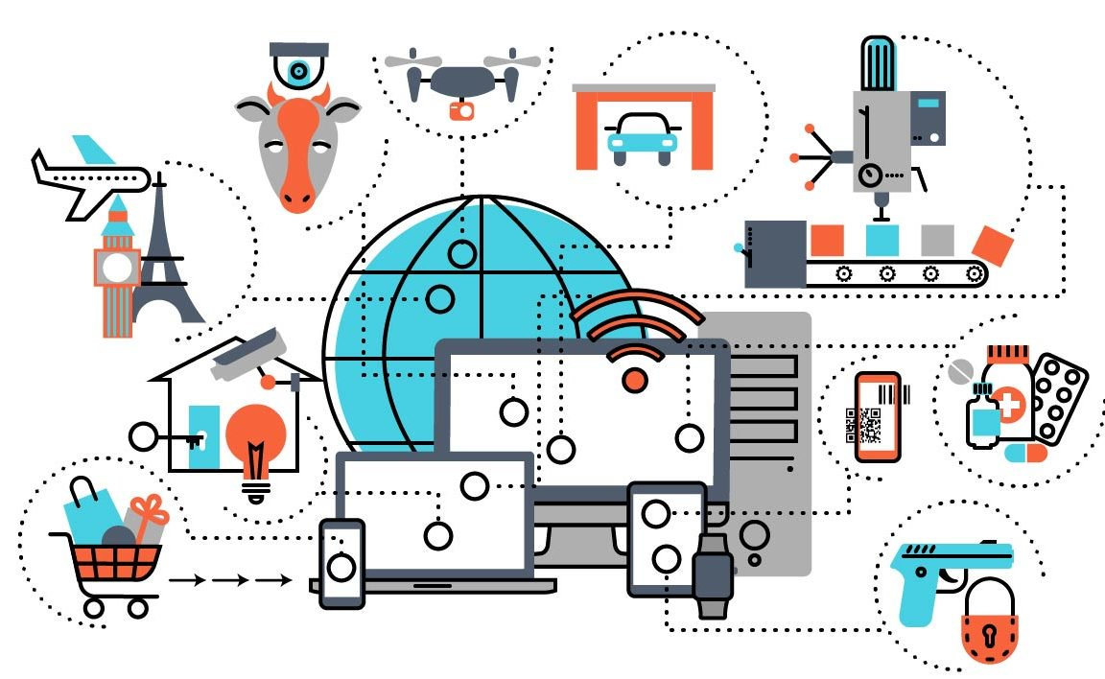
Background
Thus, 5G technologies are an upgrade to the existing wireless connections as it offers higher customer experience in terms of latency, efficiency in data transfer and higher reliability.
This wireless connectivity acts as a major catalyst for the currently ablaze technology, Internet of Things.
With the increased connectivity through 5G, Internet of things might be able to achieve new heights.

Slide 4
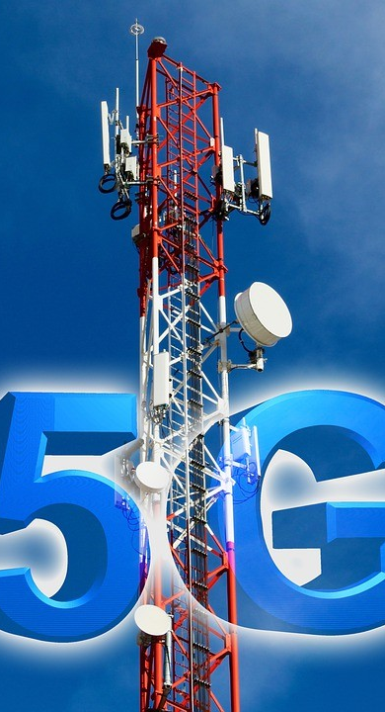

AIM OF THE RESEARCH
The aim of the research is to
Investigate the key differentiators of 5G technology as compared to the previous 4G and 3G technologies.
Analyse how the key differentiators of 5G would act as catalysts in rolling out IOT.

Slide 5

MOTIVATION
ENHANCED CUSTOMER EXPERIENCE
With internet growing at an exponential rate, it becomes mandatory that the user experience of the customers is enhanced by offering them a much reliable connection which has decreased latency and higher data transfer.
Further, the enhancement in technology is making the environment smarter which establishes the need of technologies which have higher connectivity and are much more smarter, efficient and competent than the pre-existing ones.

Slide 6

Objectives of the research

Slide 7
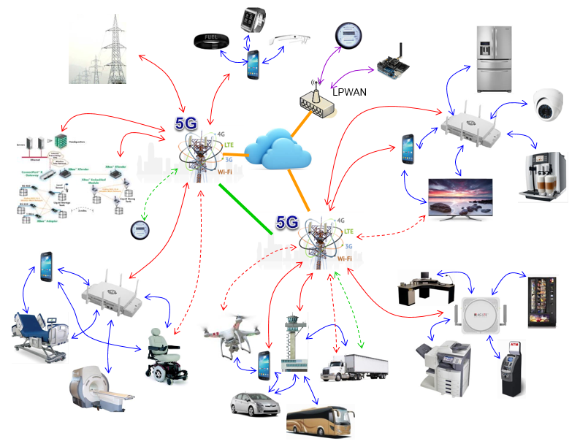
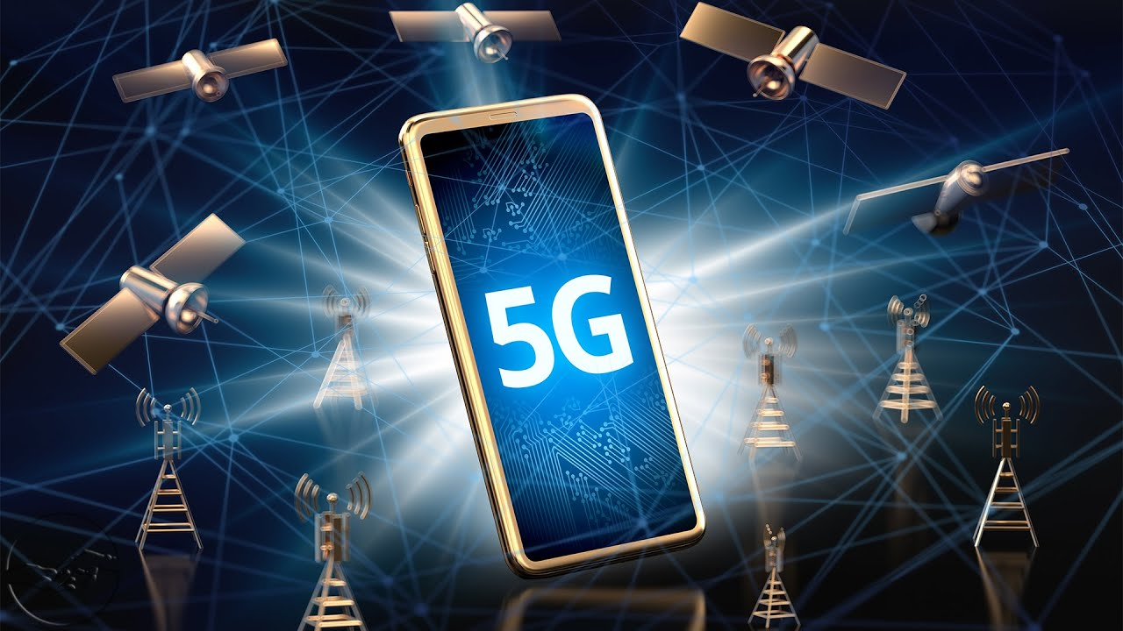
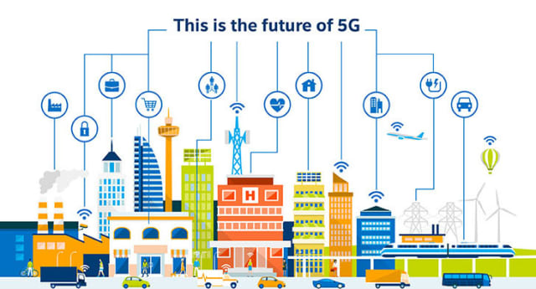
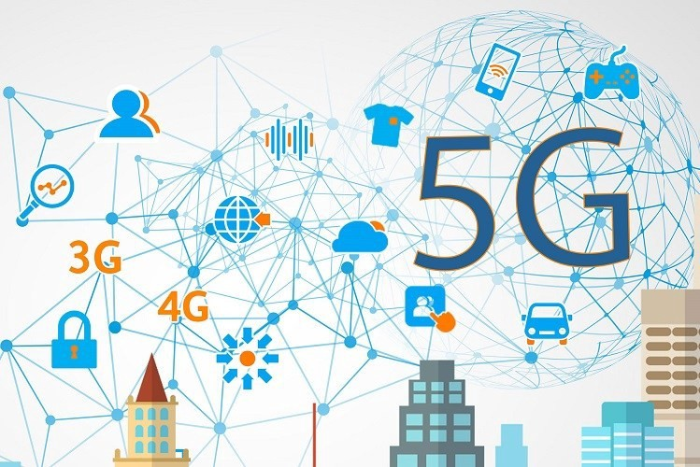

OBJECTIVES OF THE RESEARCH
Using simulation technologies (Vienna 5G system level simulators) for investigating the key differentiators of 5G as compared to 4G and 3G.
Investigation of how 5G has the potential of rolling out IOT

Slide 8
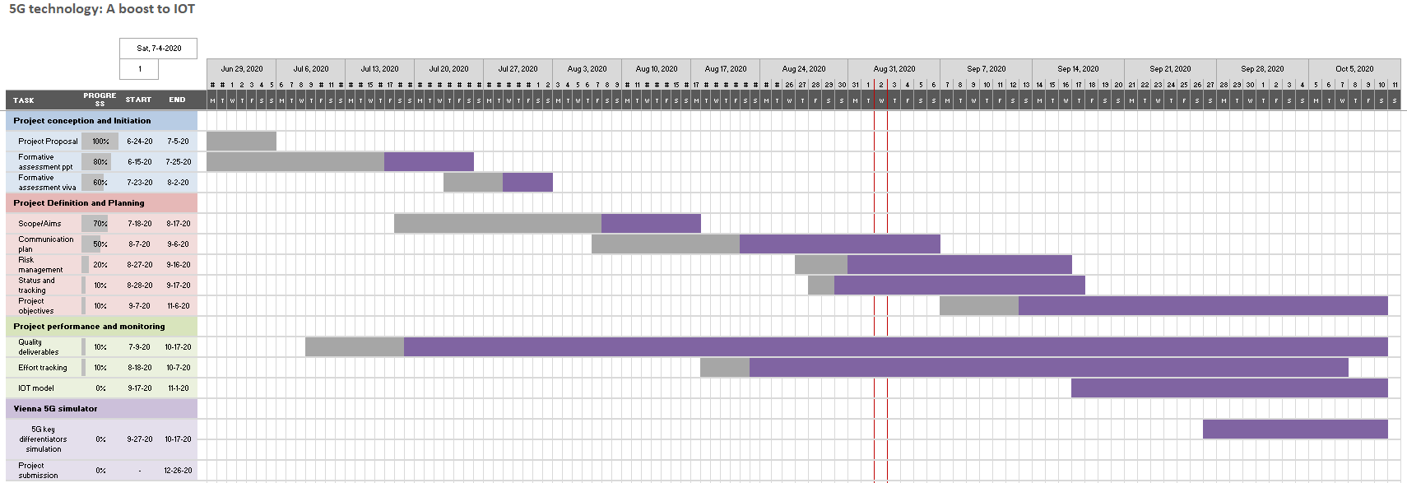
PROJECT PROGRESS

Slide 9

OBJECTIVES ACHIEVED
The objectives that have been achieved till now are
Preliminary research about the five key differentiators of 5G
Research about the simulation software i.e. Vienna 5G system level simulator
Preliminary research on milli-meter waves and how they can be used for an efficient long distance communication

Slide 10

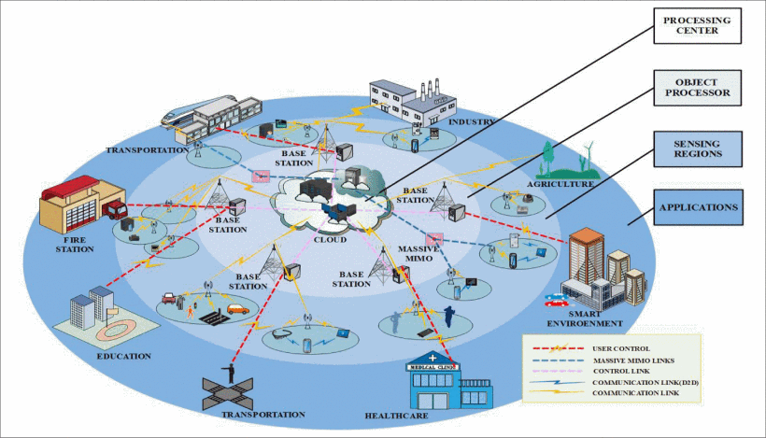
PRELIMINARY RESULTS
duiet facilisis.
5G technology would come out to be efficient and competent compared to 4th and 3rd generation internet.
Based on the objectives achieved
The results based on the 5 differentiators are:
HetNet allows unification of diverse varieties of cell sites
MIMO provides 5G with the potential of high speed
Auxiliary spectrum bands or the millimeter waves allow higher spectrum allocation size
The SDN in 5G provides a better routing architecture

Slide 11
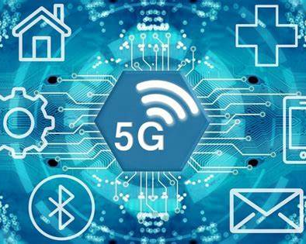


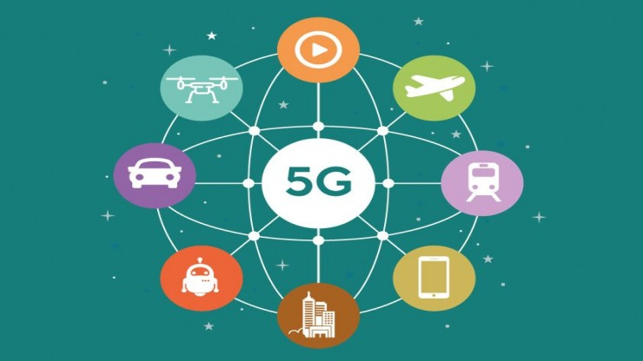
PROBLEMS ENCOUNTERED
DEFINING OF OBJECTIVES
TIME MANAGEMENT
Listing of in-scope aims and defining objectives based on the area of investigation
Managing time for all the research and the project has been an obstacle for the project in the initial weeks.
SIMULATOR FOR 5G
COMMUNICATION PLAN
The simulation of 5G to analyse the key differentiators required a simulator. Thus, problem was faced in finding an efficient simulator
The development of an efficient communication plan was the problem faced in the project

Slide 12
RESOLUTION PLAN
DEFINING OF OBJECTIVES
TIME MANAGEMENT
To solve the problem initially, Gantt chart has been created for the project.
The next plan is to use Trello for building a trello board that would divide the project into sprints
A few steps were performed for defining the objectives:
Brainstorming/critical analysis
Peer discussion
SIMULATOR FOR 5G
COMMUNICATION PLAN
To find an efficient simulator, the discussion with my teacher helped draw the conclusion of using Vienna 5G system level simulator
The communication plan that would be highly efficient is Skype as the meetings could be easily recorded.

Slide 13
FUTURE PLAN
The future plan for the project would be followed according to the Gantt chart that has been created. The main milestones under the future plan are:
5G in rolling out IOT
Latency of 5G in IOT applications
Millimetre waves analysis and dependency of 5G upon them
Simulation of 5G on Vienna system level simulator

Slide 14
ASSOCIATED ISSUES

Slide 15

ETHICAL ISSUES
Effects of radiations have been identified as highly harmful by many health organizations. Thus, in case of harmful radiations associated with 5G, the project would not be implemented for use.
The privacy of the individuals might be hampered when the entire globe is knit through IOT.
High power consumption is also an ethical issue

Slide 16

LEGAL ISSUES
The legal issues associated with the project are:
Data privacy and protection
Liability issues
Data ownership
Cyber security
Intellectual property rights

Slide 17
PROFESSIONAL ISSUES
The professional issues associated with the project are:
Transparency about the project
Adherence to the regulations
Professional decision making
Risk analysis

Slide 18
CONCLUSION
Thus, it can be stated that the project plan has been created based upon the objectives of the research and the achievements of the project include analysis of 5G as compared to 4G and 3G on the basis of simulation and thus predicting the efficiency of 5G in rolling out IOT.

Slide 19
THANK YOU

